Slide 1
Hello world
Lesson 00

Slide 2


Slide 3
My goals
Better code, with maximum efficiency and communication
Make you love computers
Outside world sneak
Have fun

Slide 4
GIT
Lesson 01

Slide 5
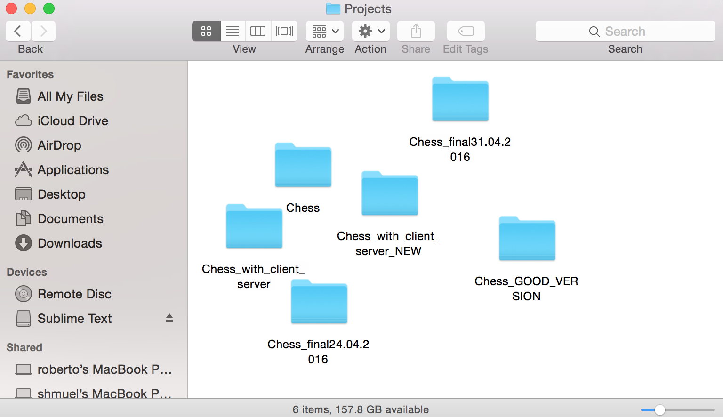
What the hell?!

Slide 6
Source control to the rescue!

Slide 7
Source control
Keep track all the changes in a project
Work together on the same project
Tag versions
Separate development branches

Slide 9
Linus Torvalds
Developer of:
Linux
GIT

Slide 10
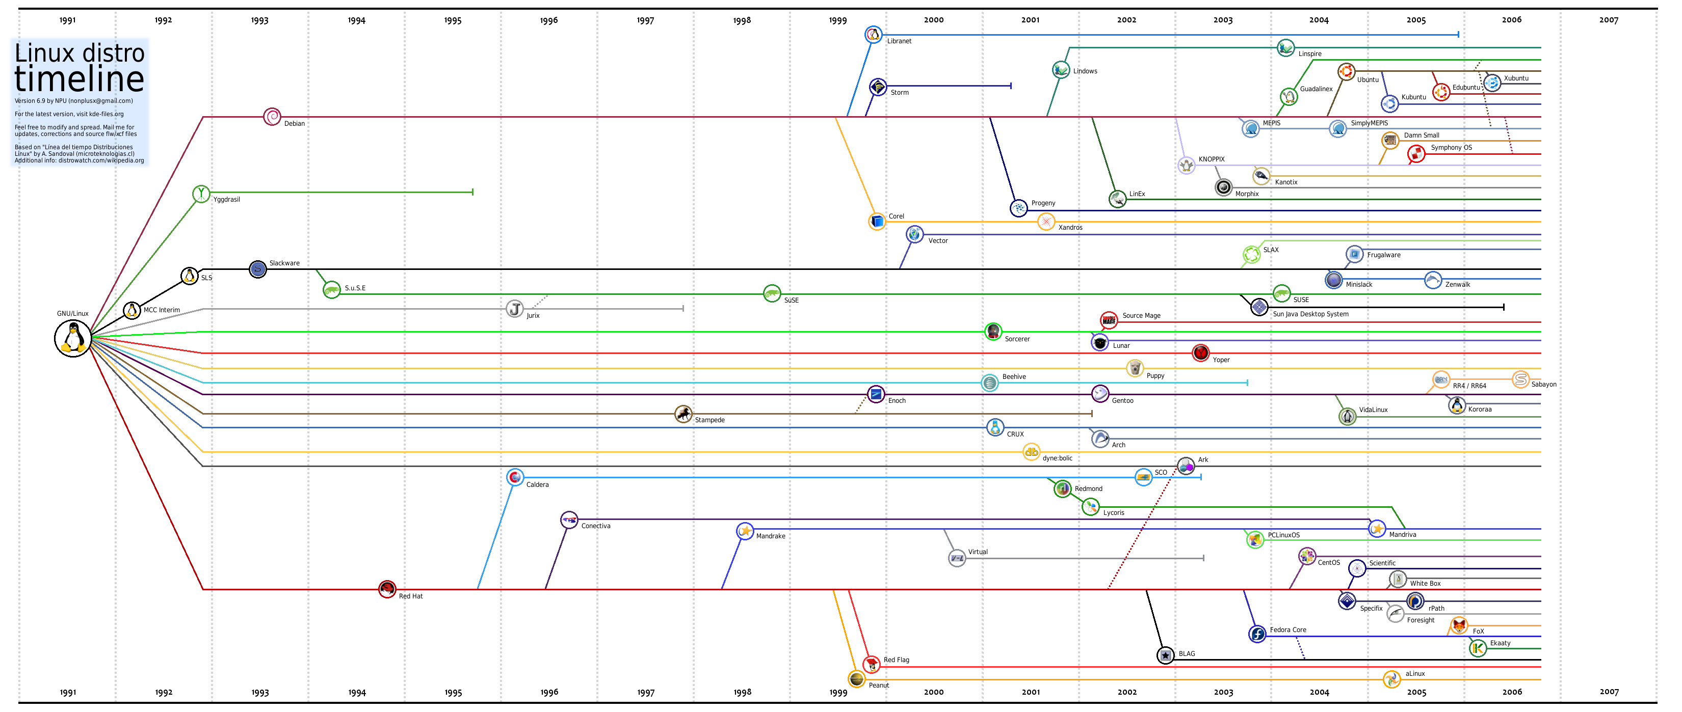

Slide 11
What is GIT?
Source control
Manages code repositories

Slide 12
GitHub
One of the most public GIT servers
Rich web interface
AnatolyProjects

Slide 13
Demo
Demo demo demo…
Remember: GIT is like a card game. You can’t truly learn it until you try it.

Slide 14
How to continue
Install GIT: https://git-scm.com/download/win
Install SourceTree: https://www.sourcetreeapp.com
Create a GitHub account: https://www.github.com
Clone https://github.com/shlomibs/AnatolyProjects.git into a local directory, in c:\Projects. – From SourceTree or from CMD
Inside c:\Projects\AnatolyProjects, create a directory in your name
Inside the directory, create a README.md file. Leave it empty for now.
IF YOU HAVE REACHED SO FAR, STOP AND CALL THE TEACHER BEFORE THE NEXT STEP
Commit your changes to a new branch. Branch name = your name
Push your changes

